Slide 1
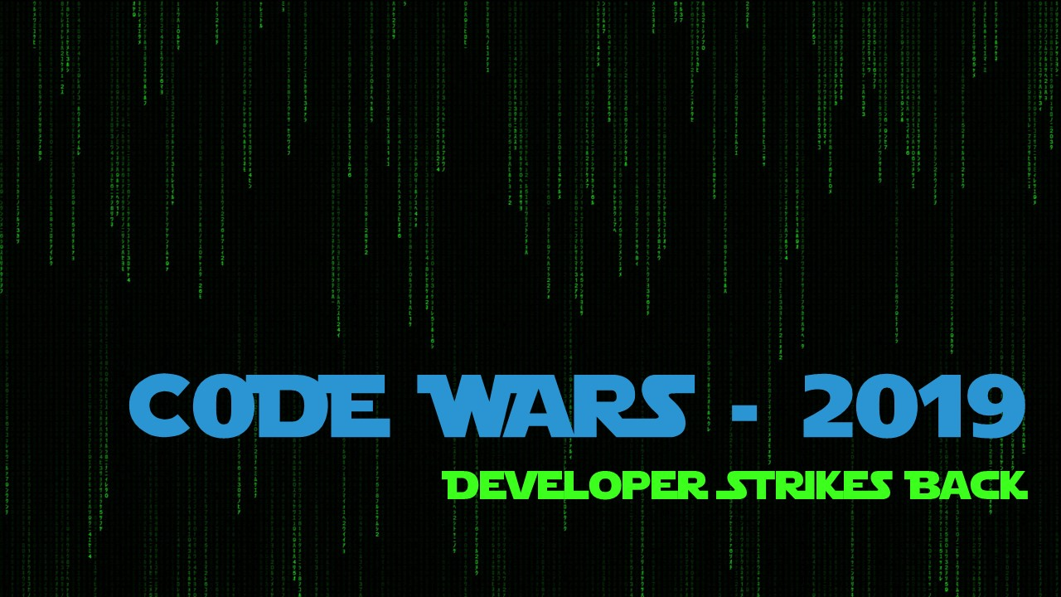

Slide 2

Rudra Roy
Ayush Gupta
Kruthika S
Debjeet Dam

Slide 3
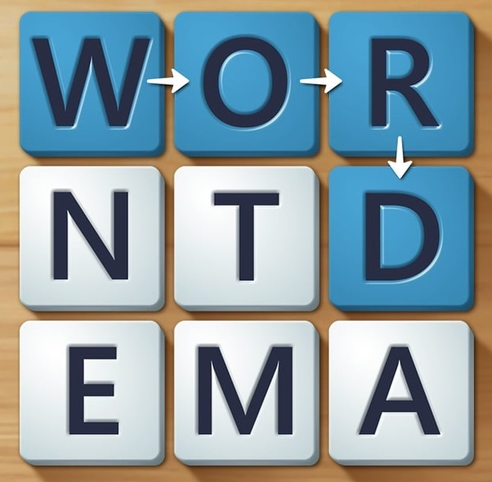
PROJECT

Slide 4

Introduction
Wordament is a word puzzle game. Players form meaningful English words by clicking alphabets in the required order to score points.
The game was originally made by Microsoft which you can play under the CLASSIC mode. New innovative modes have been introduced in this web application namely SCRAMBLE and JUMP AROUND.

Slide 5

Rules
Alphabet tiles need to be selected in the required order to form words.
1 and 2 letter words are not considered. Ex – I , DO
Selected tiles cannot be selected again.
Classic & Scramble mode – Neighbour tiles of the last selected tile which are not selected already are allowed to be selected.
When a combination formed by the player has no match or a prefix match in the dictionary, the selection will reset.

Slide 6
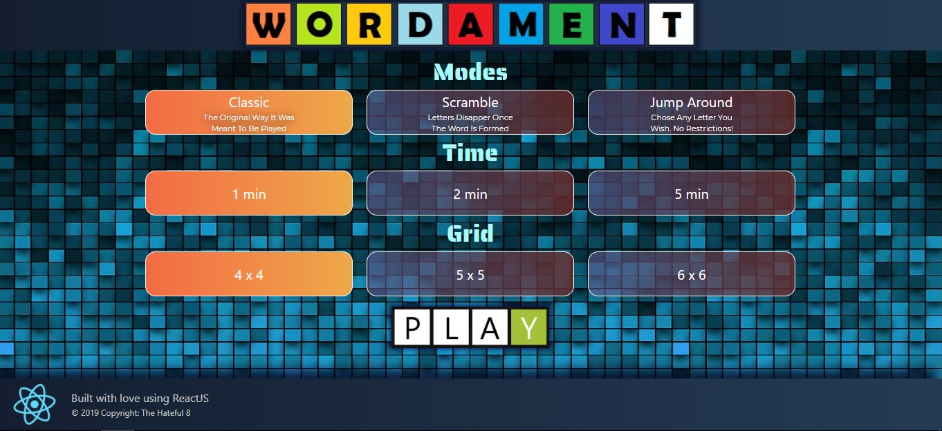
Home Page

Slide 7

Home Page
Modes
Classic - Player needs to select the letter tiles which is a neighbour of his last tile section to form the word. Once the word is formed the tiles remain.
Scramble – Same as classic but once the word is formed, those tiles are replaced with new tiles
Play Around - Player is allowed to form words by selecting any tile.
Grid – No of alphabet tiles player wants to play in.
Time – Amount of time the player is allowed to form words and score.
After selecting the mode, time and grid, player can click play to start the game.

Slide 8
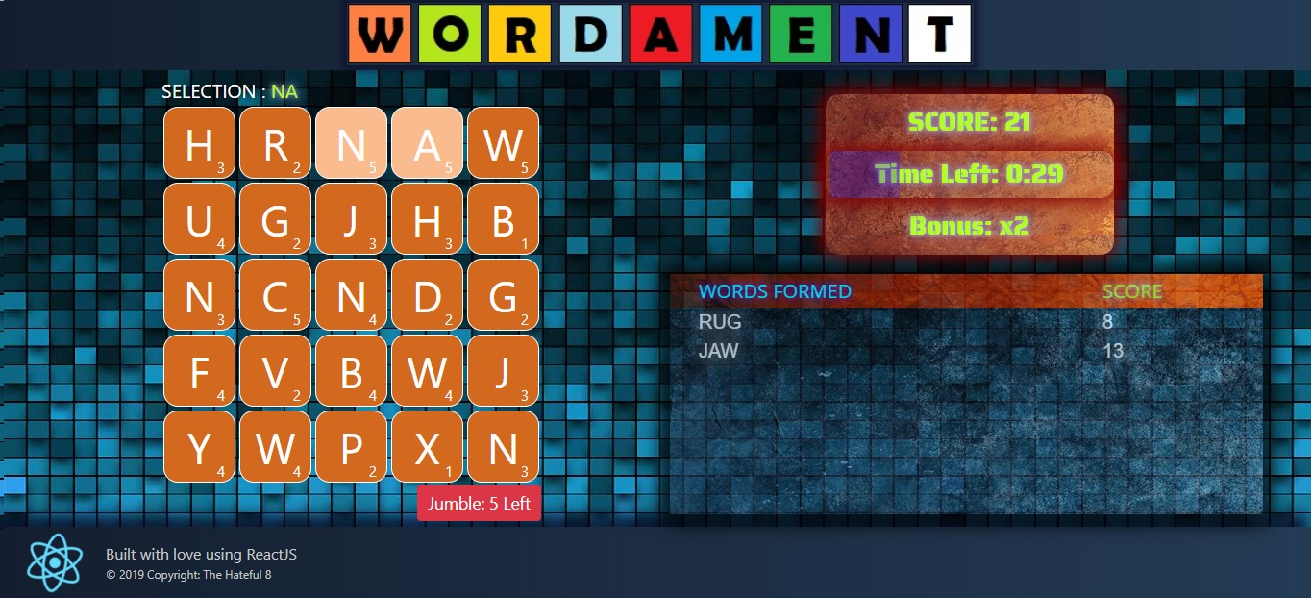
Game Page

Slide 9
Game Page
Score – Displays the total score acquired.
Time – Displays the remaining time. After which the game ends.
Bonus - On consecutive formation of correct words, player is awarded multiplied score which is incremented. Bad selection resets this to 1.
Jumble - A player is allowed to shuffle the alphabet tiles up to 5 times. This is useful if the player is unable to form a word.
Scoreboard - Displays the words formed and the score acquired from aggregating each tile value

Slide 10
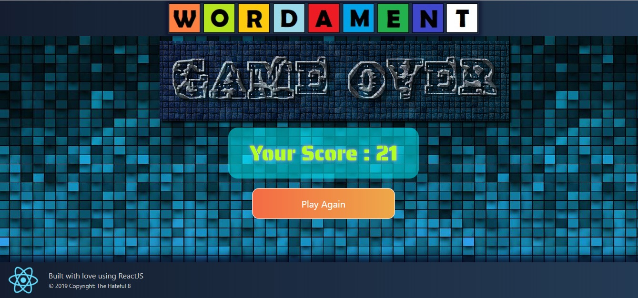
Score Page

Slide 11
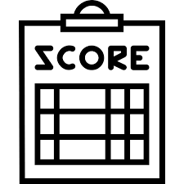
Score Page
The final score is displayed
Player gets an option to play again.

Slide 12
Implementation – Part 1
Word Check Algorithm
When the selection is more than 2 letters, it is checked for an exact match and a prefix match.
If an exact match is found, scores are aggregated.
If not a single prefix match is found, it is a bad selection and the selection resets.
If both the above fail, player is allowed to continue with the selection of alphabets.
List of words are taken from https://github.com/dwyl/english-words It has a text file containing 476k words. A script is written to eliminate 1 or 2 letter words and to index this with alphabets. The indexing is done to filter alphabetically with a time complexity of O(1)

Slide 13
Implementation – Part 2
Alphabet Tile Generation Algorithm
The alphabet tiles are generated randomly but alphabets with higher usage frequency have more weightage. Alphabet frequency data is taken from https://en.wikipedia.org/wiki/Letter_frequency
This frequency is scaled up to round about integers and a script is written to generate an array containing the alphabets repeated to match the frequency. Randomly alphabets are selected from this array.

Slide 14
Scope
User registration and leader board
Enable players to register. The best scores for each mode x each time form a leader board page. This requires a backend and was not built as scope of this project is limited to ReactJS.
Drag Selection and Mobile Support
Enable player to click and drag through tiles to form words. This will also enable support for mobile to swipe and form words instead of only tapping. More styling needs to be taken care of for mobile support.
Algorithm Enhancement and Optimization
Alphabet tile generation algorithm needs to be improved to cover a greater range of words and introduce difficulty level. Word check algorithm needs improvement for faster checking. 3 letter permutation indexing is one way to reduce the time complexity for this.

Slide 15
Thank You

